Slide 1
Flourishing neighbourhoods a webinar organised by The Constellation
with Jan Somers

Slide 2
Welcome to you all, from around the globe ! What made you join our webinar?
Our aim is to inspire people from around the world to facilitate for flourishing neighbourhoods, for these neighbourhoods to respond locally to the challenges they face and the dreams they have.
First session
we focus on investigating what flourishing neighbourhoods can achieve and wat can be done to see people decide to join activities for a better neighbourhood.
Second session
we shall look at the lessons learned since session 1 and introduce the community life competence process cycle.

Slide 3
Our webinar theme strongly relates to our strength based and appreciative SALT & CLCP (Community Life Competence Process) approach. Step 1 of our approach is establishing the community by getting to know who we really are.

Slide 4
What is your definition of a flourishing neighbourhood?
Write down in the Chat, in your own couple of words, what you see as a flourishing neighbourhood.
What are the common aspects we read in your definitions?
How do I see it ?
A flourishing neighbourhood to me is a community of people that recognize eachother, who feel being part of it, where there is a sense of caring and activities are being organised, in good days and bad days, for the better of all members of the neighbourhood – be it for tackling challenges or for working on a collective dream.

Slide 5
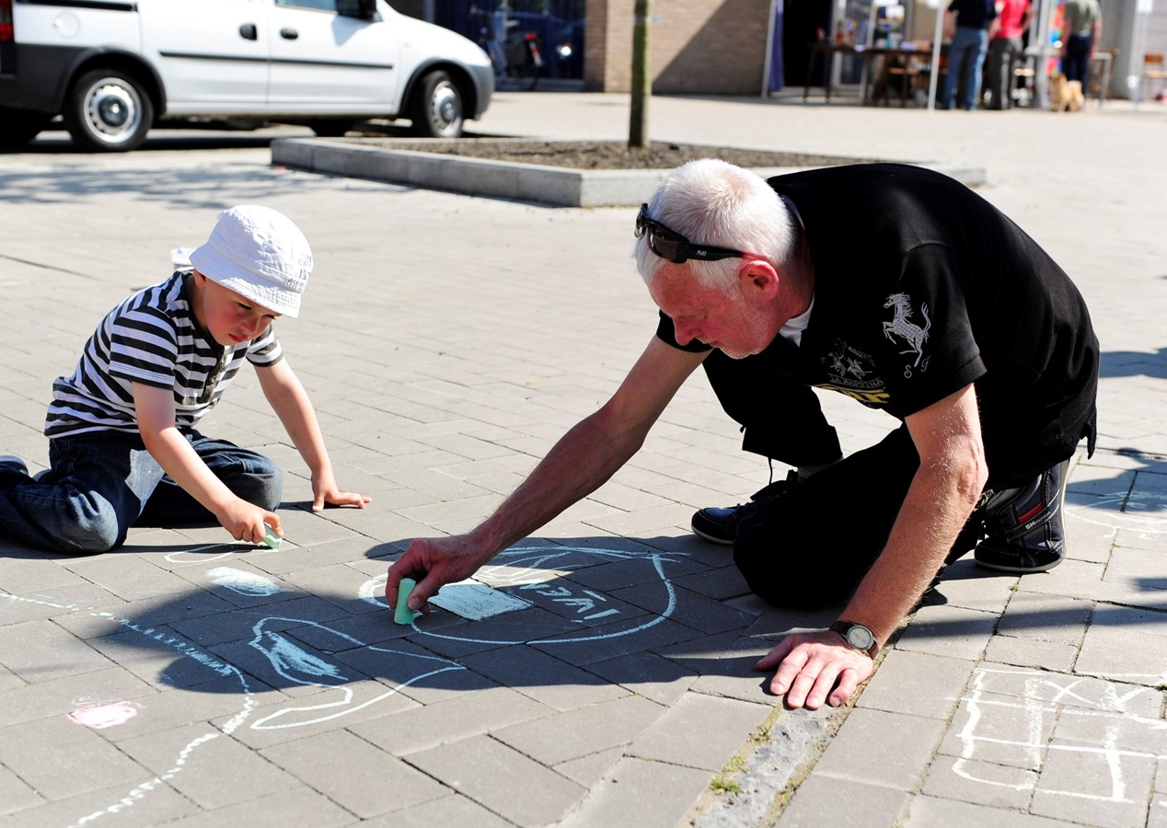
Why flourishing neighbourhoods are important:
The circumstances for humanity have changed over the years and are still changing. The climate change, the pandemic, migration and its impact on local demographics, #metoo, #blacklivematters, wealth gap, technology evolution, (geo-)political unrest, burn-out vs healthy @work, big data, … just to name a few.
All of this makes many people feel insecure, feel lonely, feel helpless, feel disconnected, … Yet many others face these challenges with optimism, eagerness to learn and see opportunities.
Collective local neighbourhood responses to many different challenges are more viable /feasible than individual responses .
WHAT KIND OF CHALLENGES DO YOU SEE/THINK A FLOURISHING NEIGBOURHOOD CAN ADDRESS THEMSELVES ? Think about it for a moment and then write your answer in the Chatbox

Slide 6
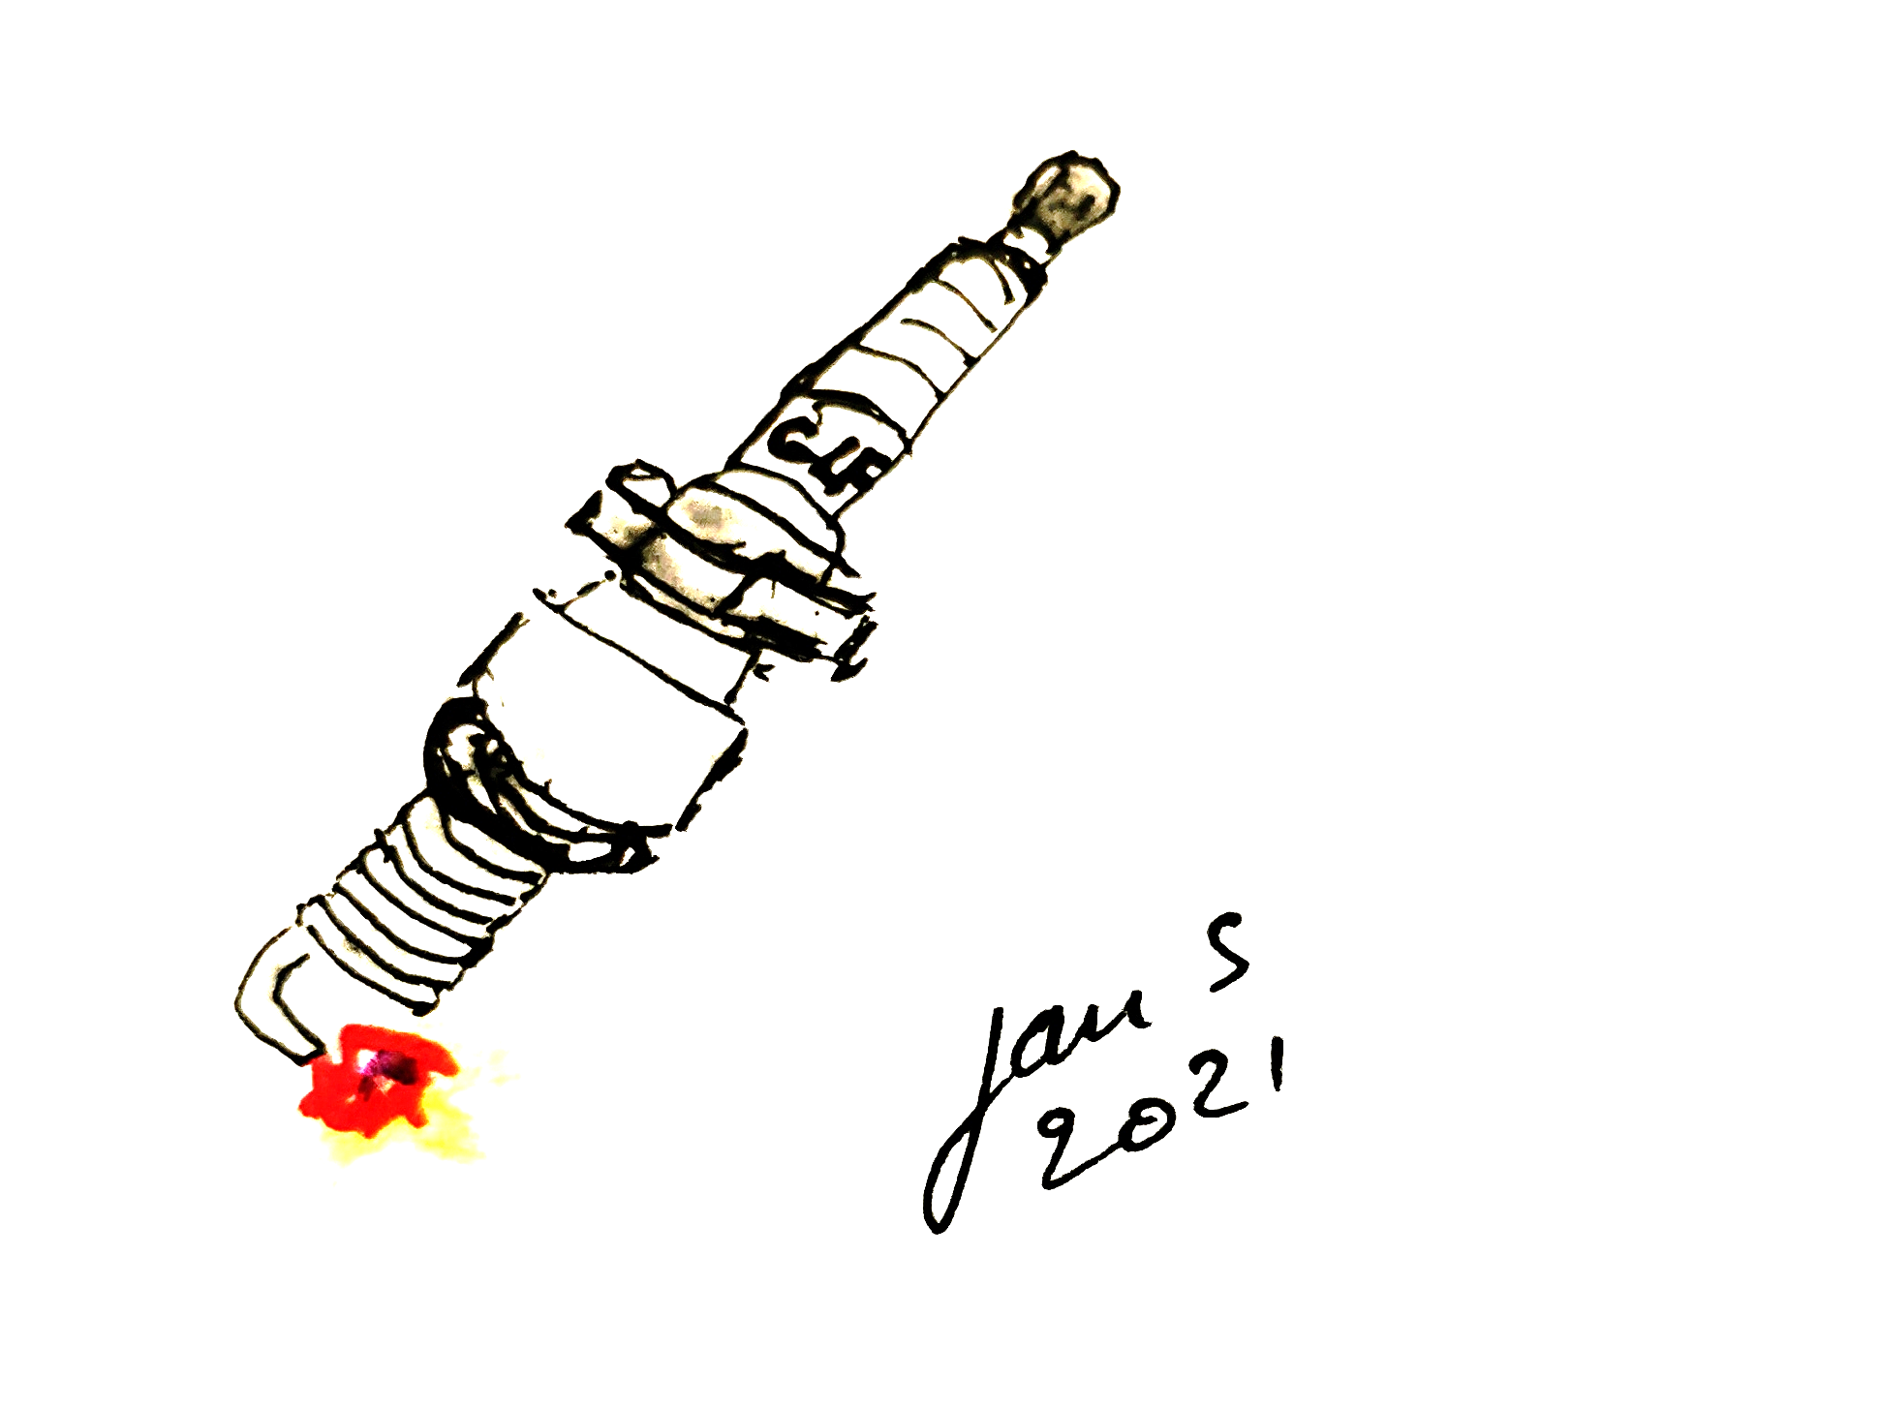
Question : “What makes local people decide to join activities for a better neighbourhood?”
Let me take you first to the Spark Plug you see here on this slide.
A spark plug makes a combustion engine turn, makes a vehicle move, and brings you to where you want …. But ….
What is needed for a spark plug to do its job well?
How does this relate to community and neighbourhood building?

Slide 7
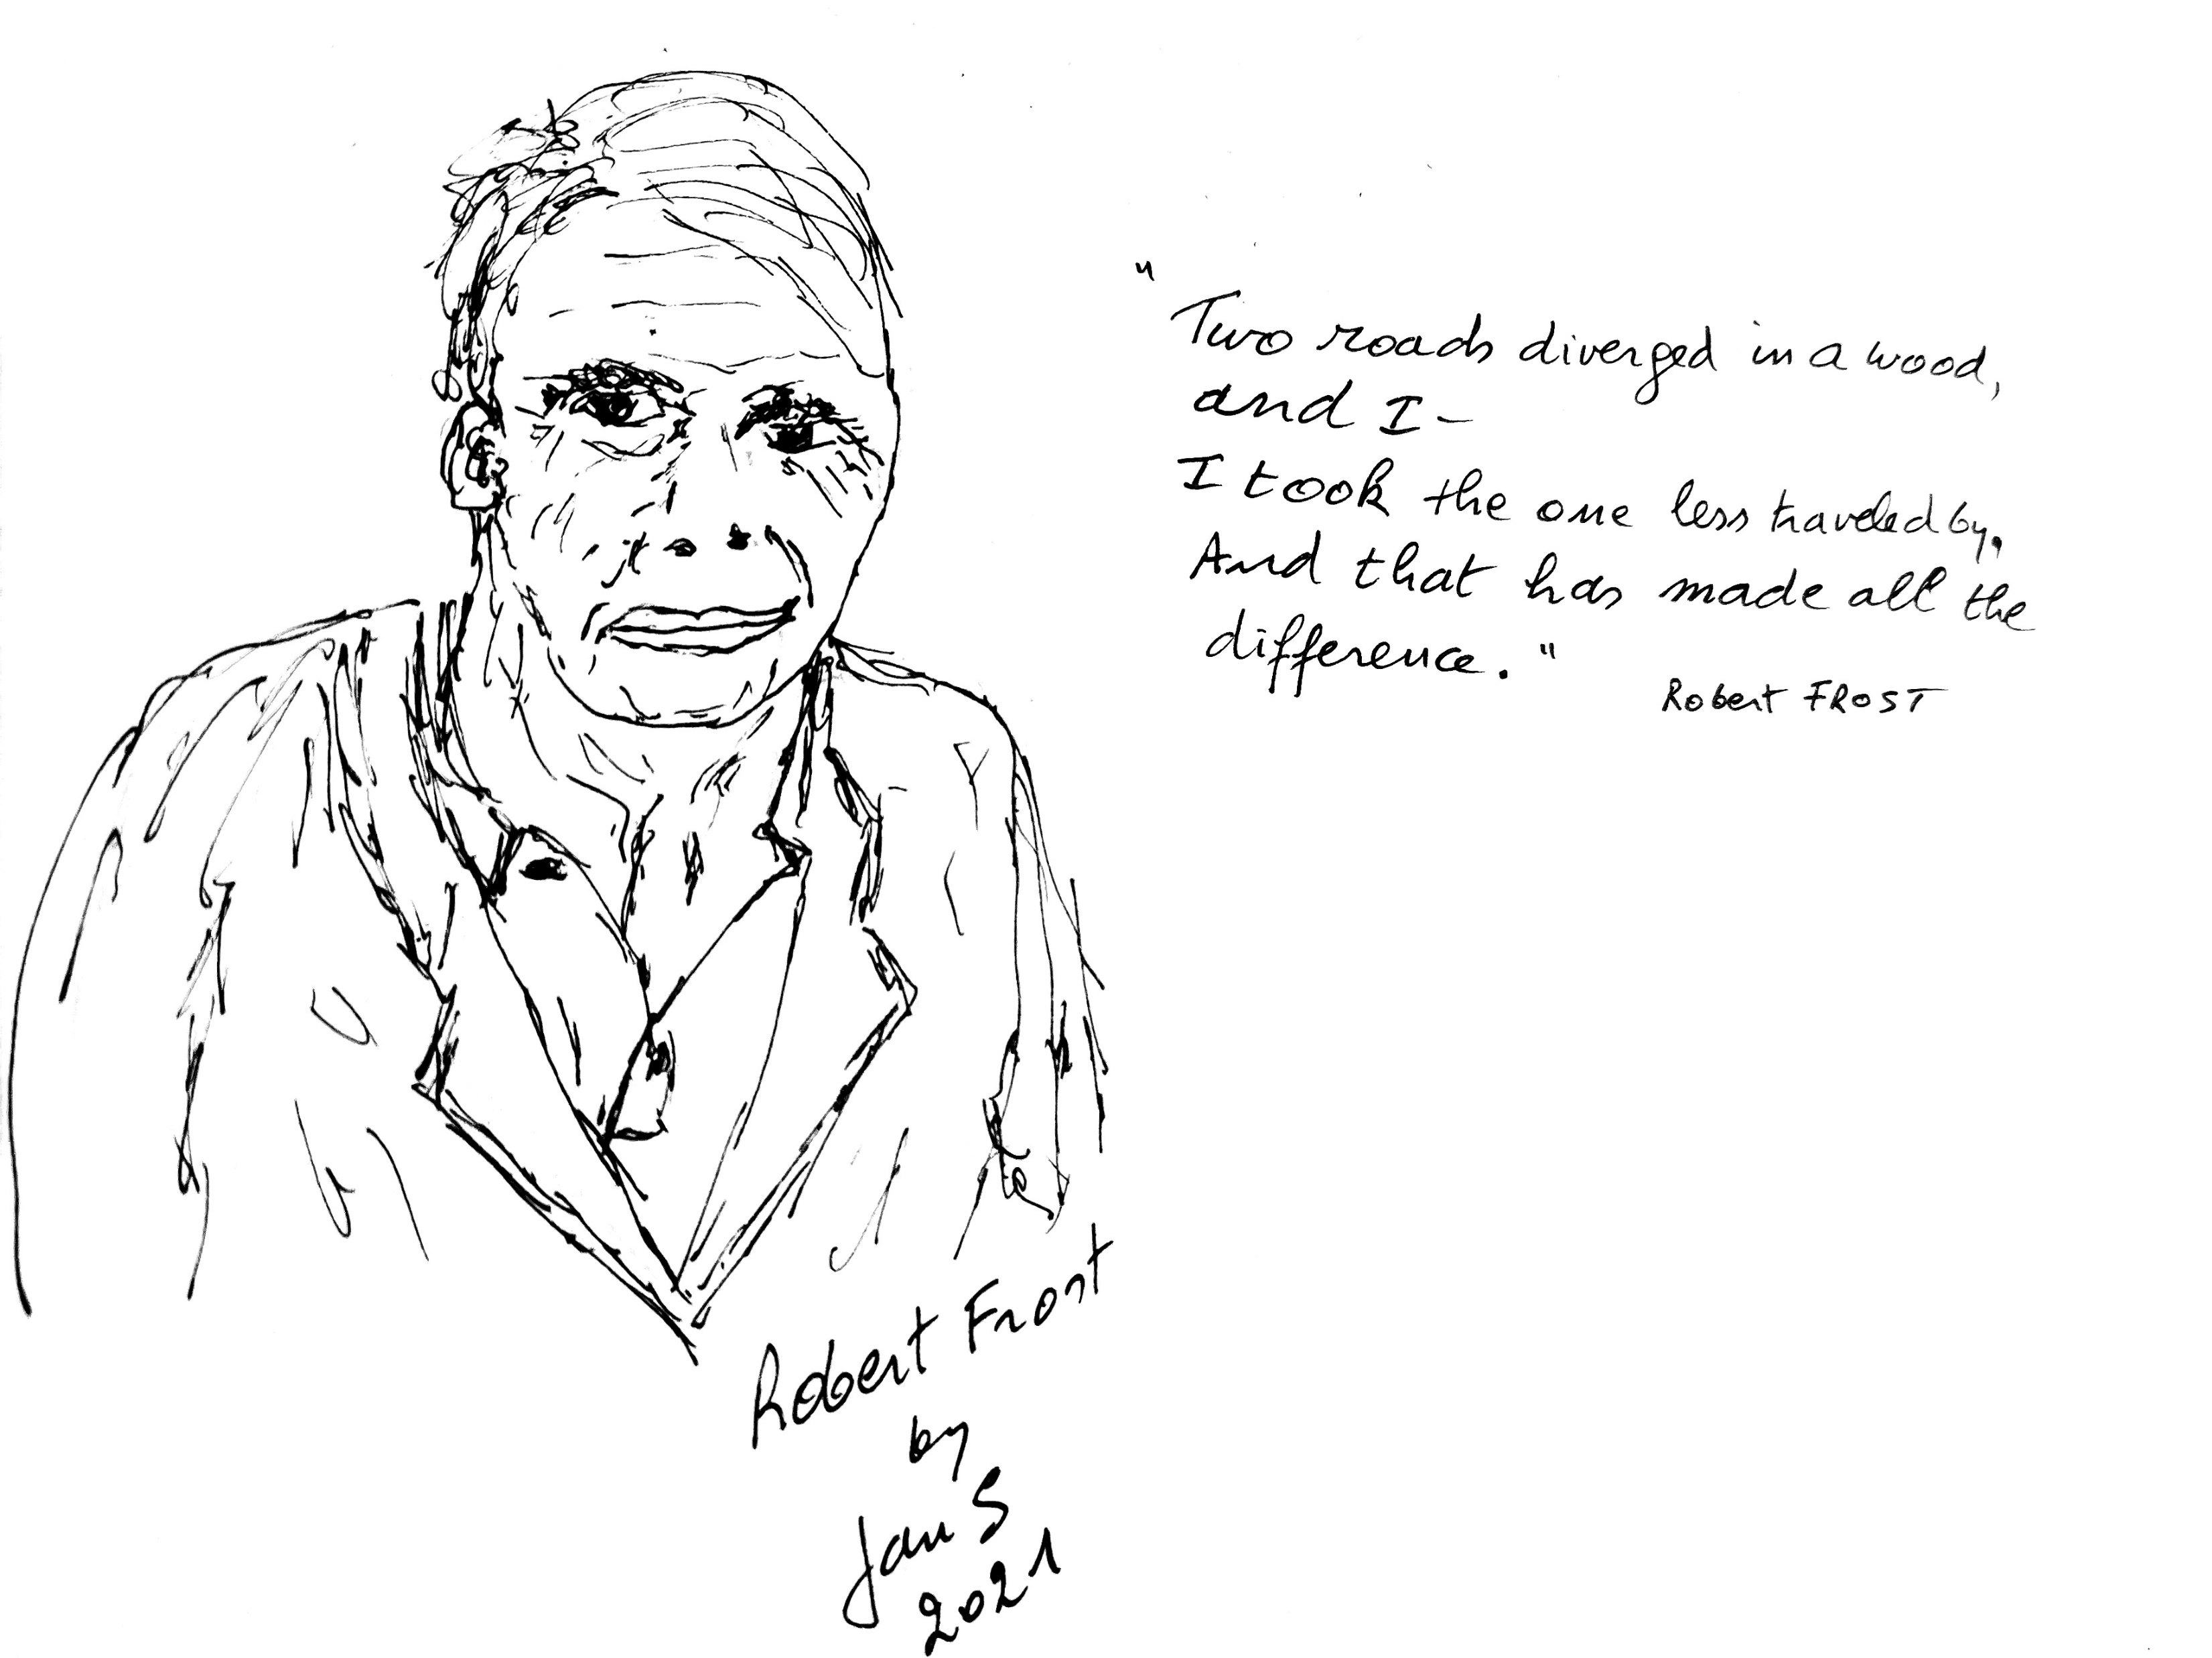
The question again : “What makes local people decide to join activities for a better neighbourhood?”
Let me share some insights/ stories from communities in Kenia Africa, Singapore Asia, Belgium and Holland Europe.
These communities use the SALT-CLCP approach as an inspiration for a neighbourhood respons.
What can we learn from them?

Slide 8
Youth group in Eastern Kenya
Youth got together and made bricks.
It was hard physical labour
so boys focused on making bricks
while the girls cooked for them.
“We learned how to make chapatis”
said Florence. And voila in a month
they made 20,000 bricks!
from blogpost by Rituu
on visiting the youth group
during the virtual
Global Learning Festival

Slide 9
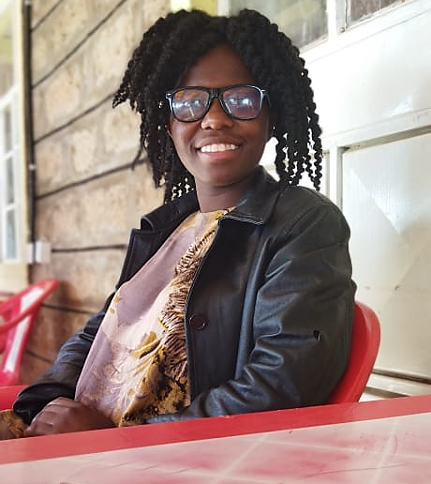
When asked Florence Mwikali what the elements/ activities/ factors were that made youth members to decide to join the group for the better of the community, this was her inspiring reply:
Inventions and innovations sessions by youth leaders with expertise (University and college youths in collaboration with concerned leaders) created a sense of belonging and purpose.
Reliable and efficient leaders.
Financial/emotional/psychological support.
Opportunity for them to learn better problem solving and decision making skills.
Organised leisure activities. Avenue to showcase their talents.
To change the community of tomorrow and making it better
To educate others that its worthy living in the community
despite what comes in their way and to have a knowledge to respond into a positive way.

Slide 10
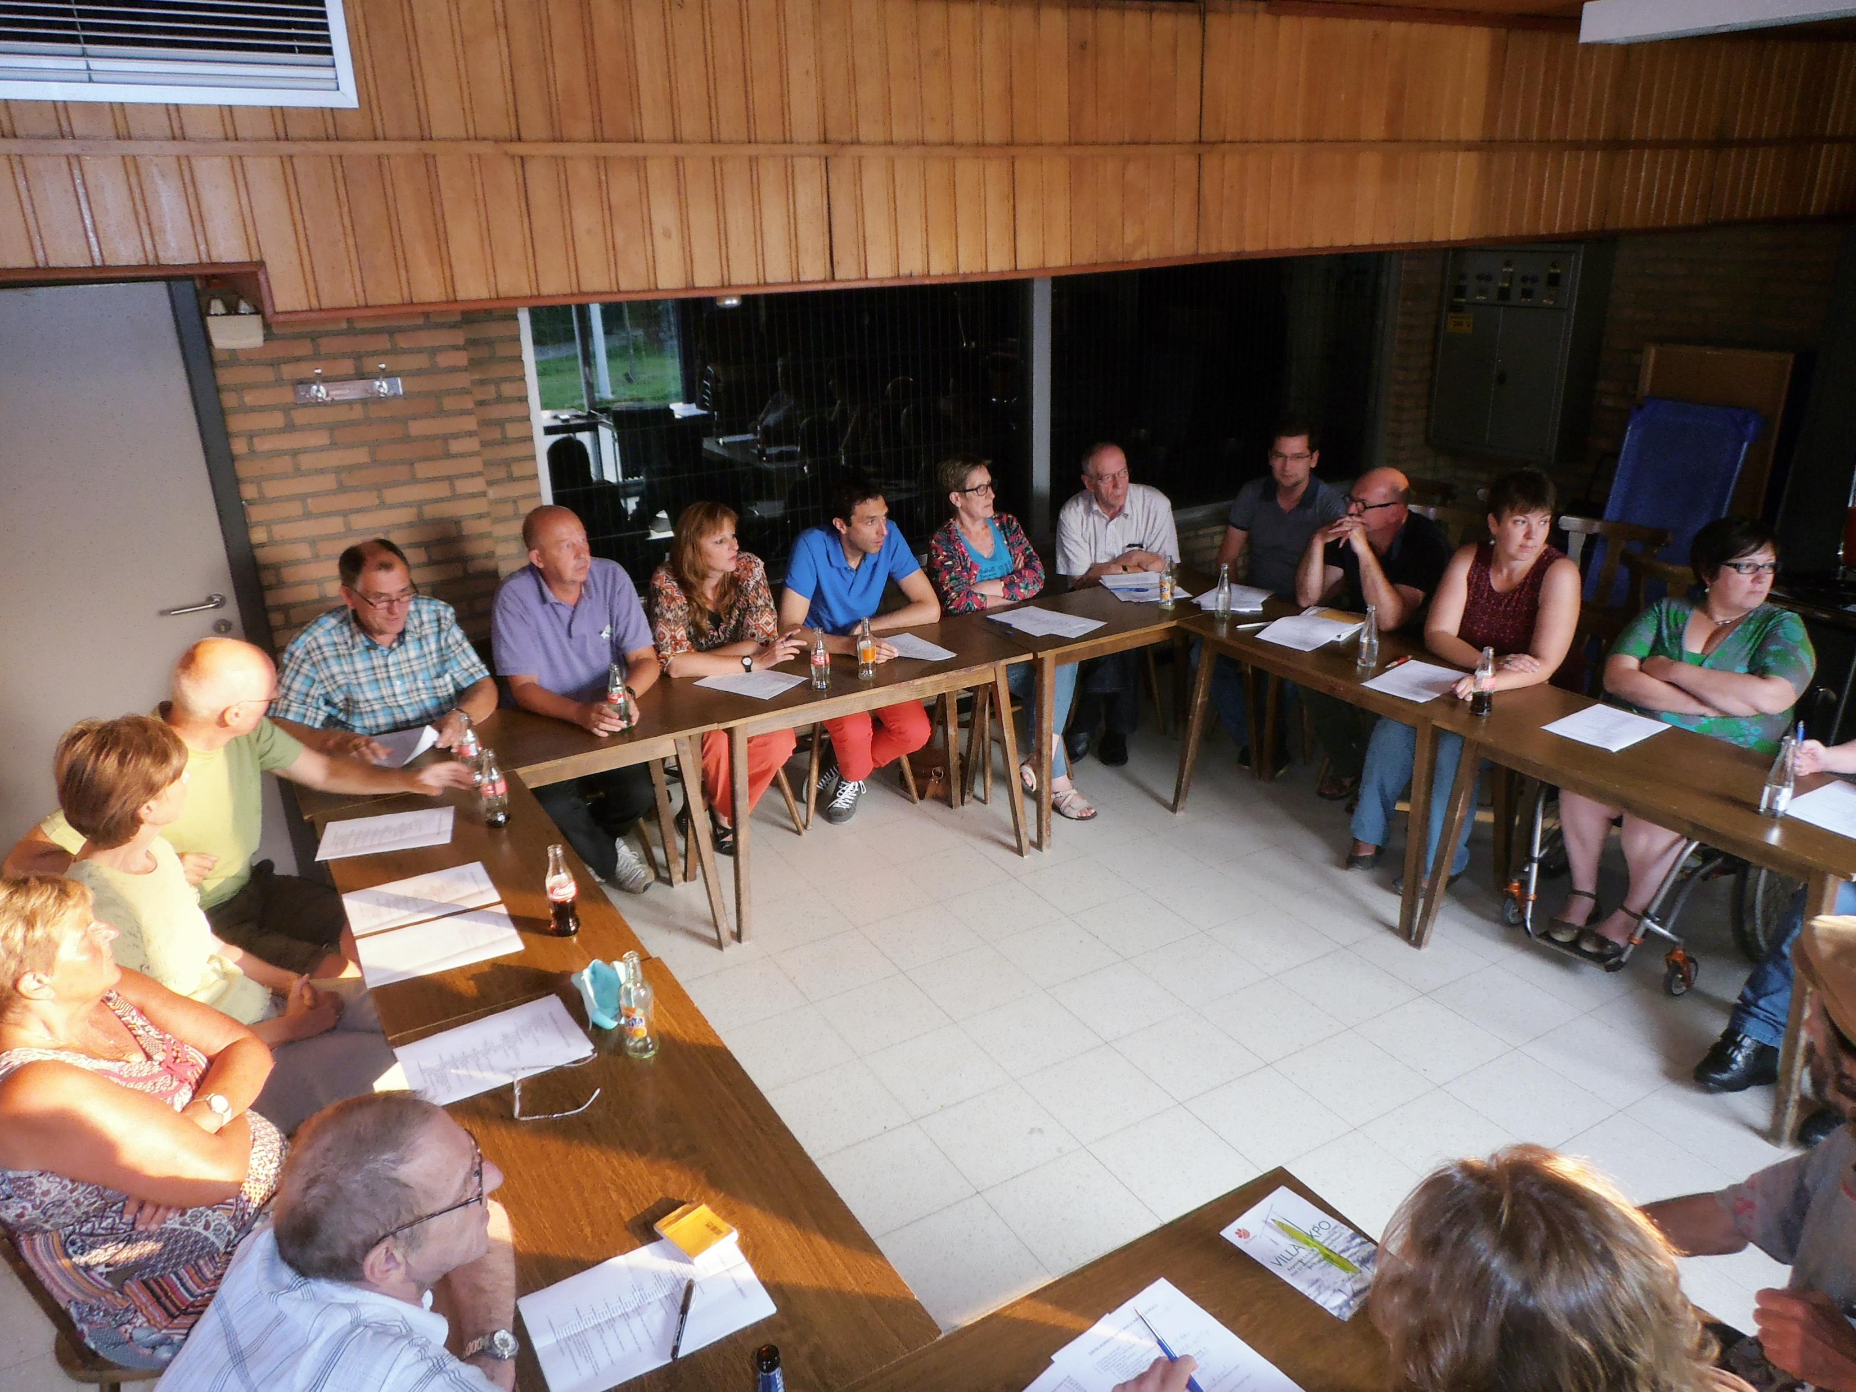
What we can learn from Vilvoorde (B) neighborhoods:
Started with 1 neigbourhood (Faubourg) and based on its success, expanded to other neighborhoods of Vilvoorde.
Faubourg started with small group that connected via SALT conversations in a central place . These experiences led the participants to invite others in as well. A team of volunteers was established to organise a community event . This led people from Faubourg sharing their dream for the community which in turn led to doable actions, supported by the city council.
The other Vilvoorde communities started with small group conversations. People were invited to share their sentiments about the neighborhood – framed in a positive, dreambased way. The shared dream helped connecting the people and to expand the number of participants from the neibourhood. This made doable actions possible.

Slide 11
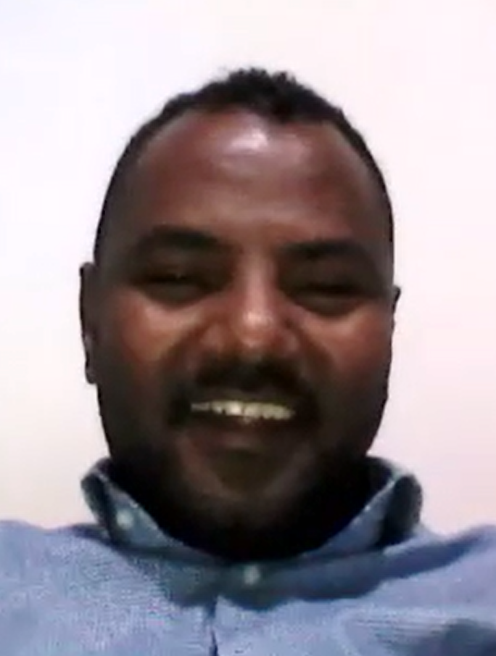
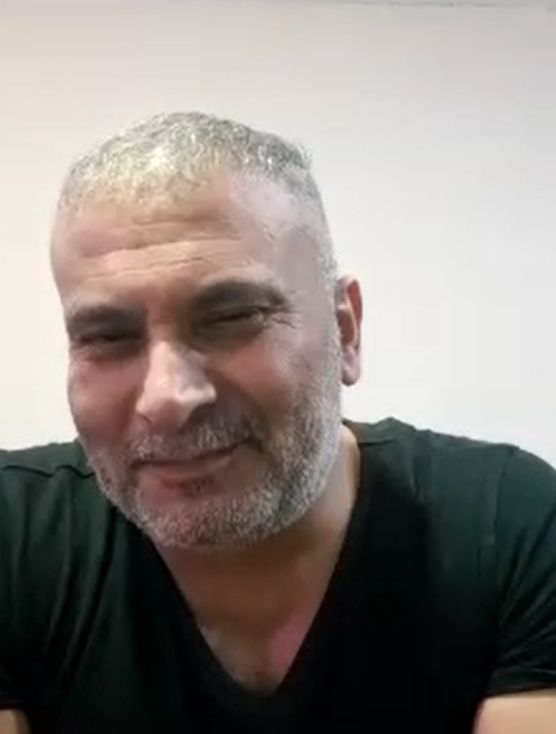
Looking back for a moment with the family Badawi and Yazeed Said, facilitator Common Ground project (Amsterdam Nl)
Common Ground: newly build appartements, creating a new neighborhood with a very diverse population.
3 years ago the new residents were invited to connect with each other .
The in-flow of new residents from different origins is still going on.
Yazeed Said
Achmad Badawi

Slide 12
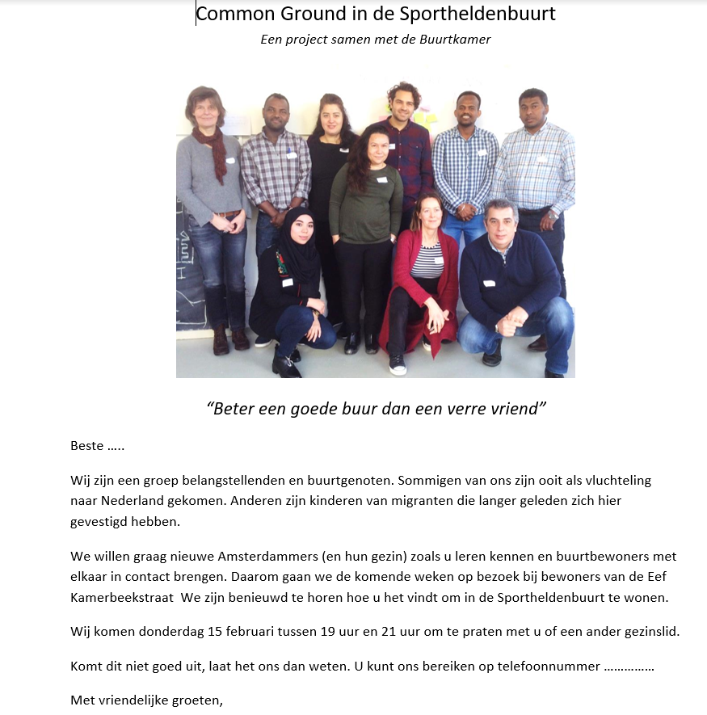
With a card and homevisits, in different languages, newcomers were invited to connect in Amsterdam.

Slide 13
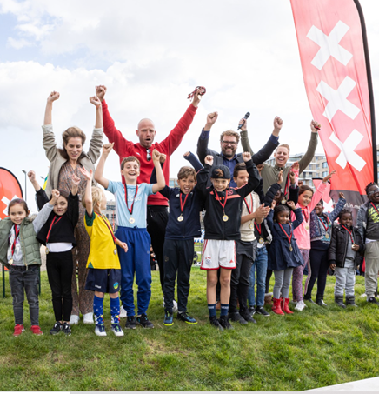
What we can learn from Zeeburgereiland Common Ground neighborhoods :
The name given to the project “common ground” is a positive focus, helping to find what unites the people as opposed to what divides them.
City of Amsterdam created a team of facilitators to ensure the newcomers would feel welcome.
Home visits by 2 visitors: who were neighbours and had different geographical backgrounds.
The reality of multiple languages among the residents is recognised hence the invitation/cards in multiple languages. Language does remain a permanent challenge for residents to meet and connect.
There is a difference in openess to meet, connect among the residing families …It takes some pacing and gentle leading initiatives towards more connections.
Common facilities in a neighborhood facilitate connecting as well: sportsfields, takeaway garden, …

Slide 14
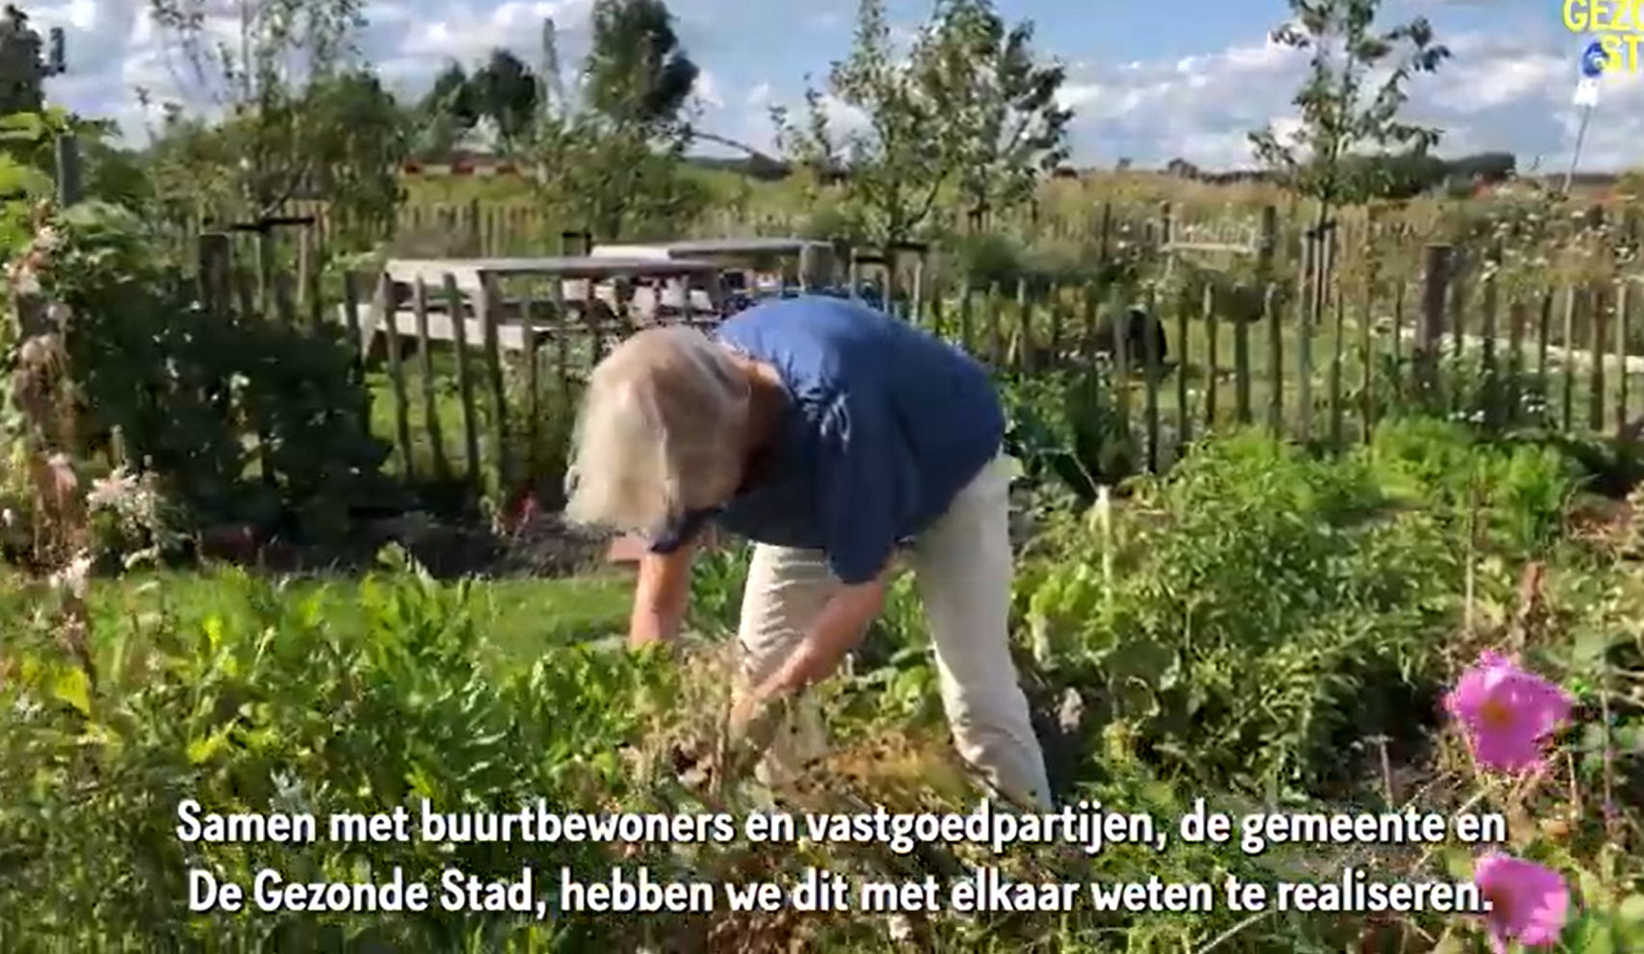
Sportheldenbuurt - Zeeburgereiland
A neighbourhood garden by and for the residents.

Slide 15
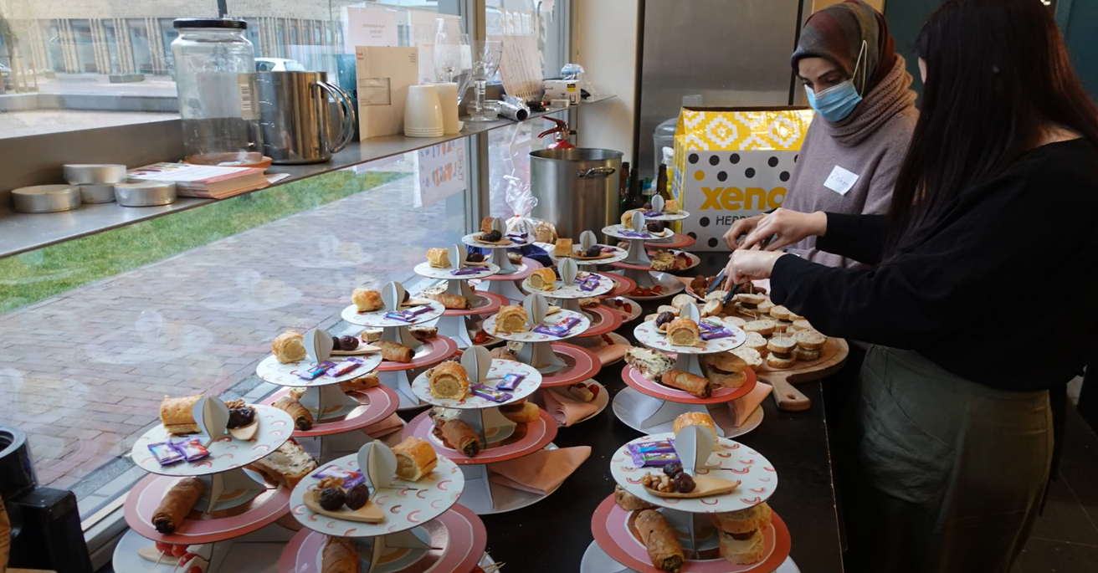
Some lessons from the Womans café in Amsterdam
Small words that matter:
“Come join and try it out
in a fun, cosy way.”
Zohra
High tea afternoon as a way to connect .

Slide 16
Some more lessons from the Women Choir & Women café in Amsterdam
“Approach somebody from his/her strength;
this makes the connection instantly more equivalent.”
“Openly speaking out appreciation
adds value to the moment,
to the other and to yourself.”
“Discovering and sharing of your own strengths
motivates others to do so as well.”
“Music is a helpful way to connect when
not speaking the same language.”

Slide 17
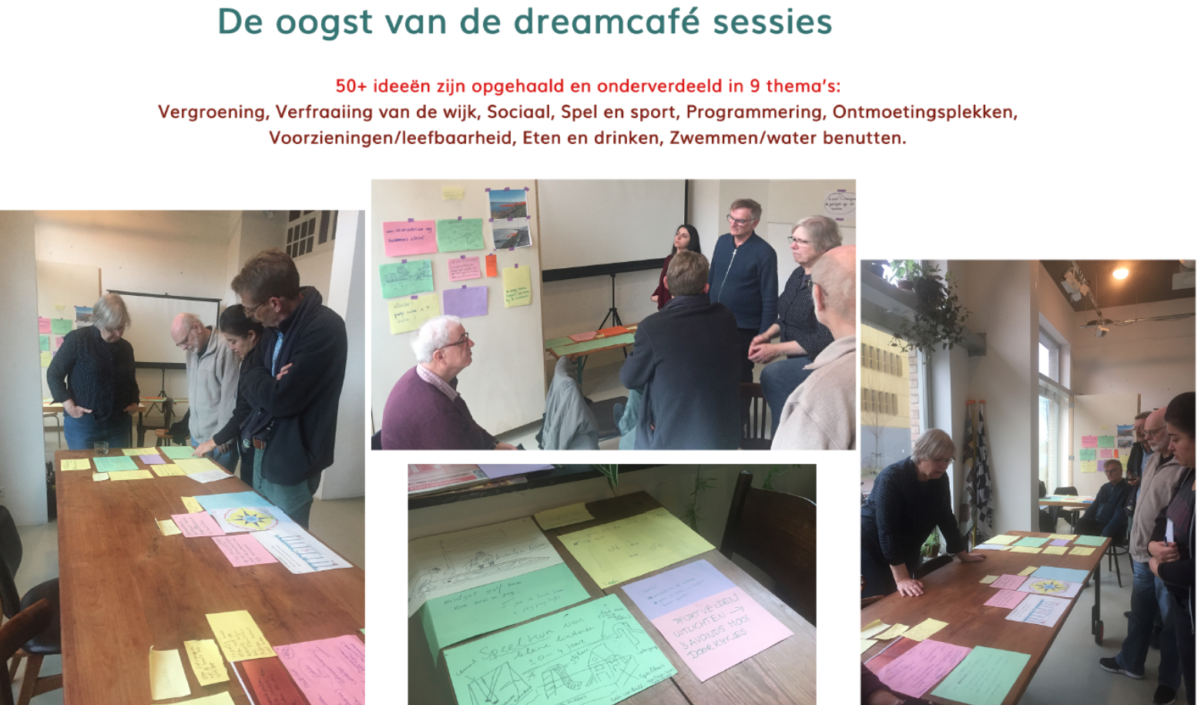
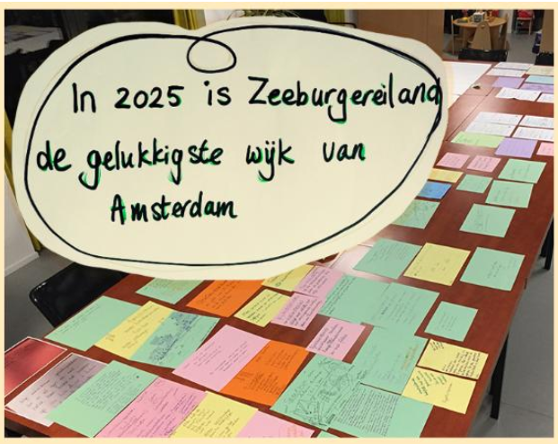
Zeeburgconnect … organisers of activities, a platform for blogs and announcements, …
Dream: By 2025 Zeeburgisland becomes the happiest neighbourhood of Amsterdam

Slide 18
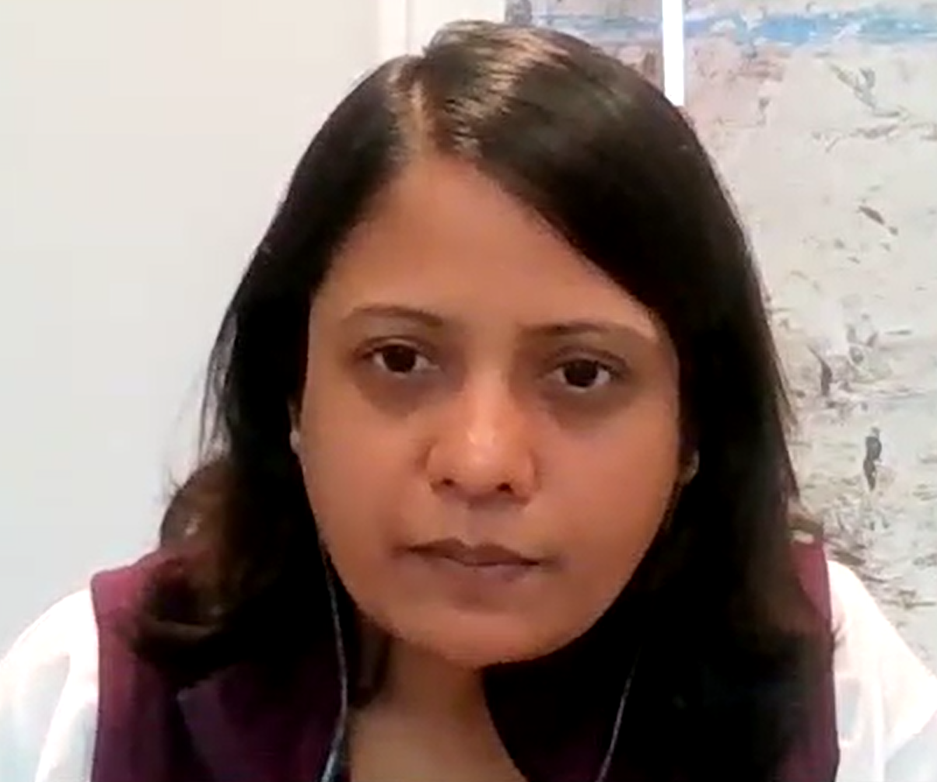
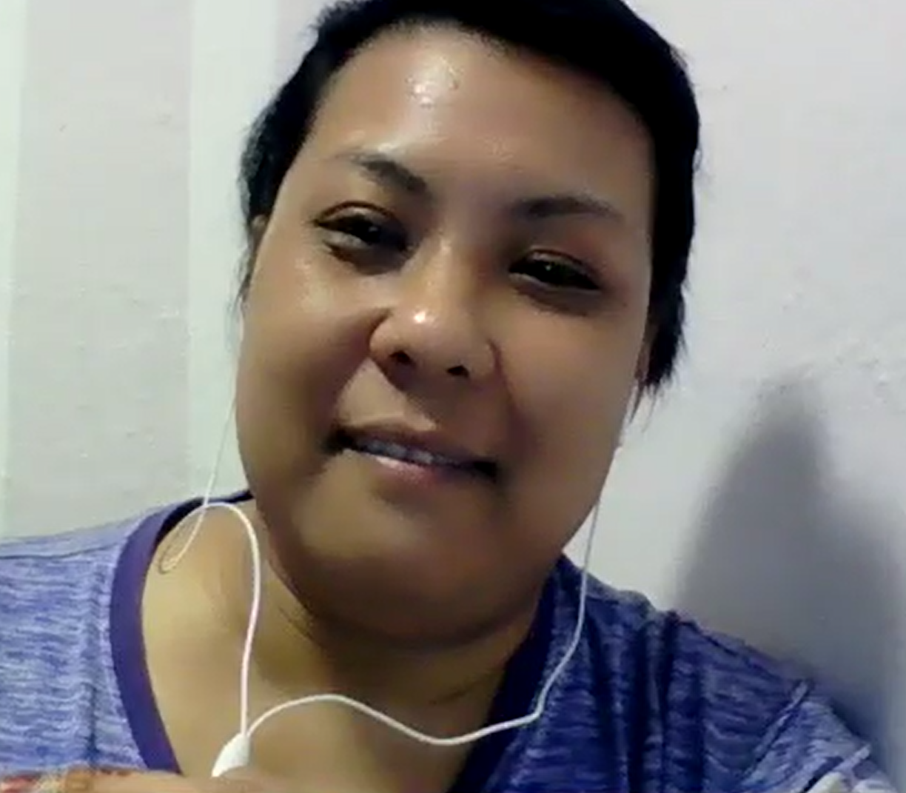
An inspiring learning conversation with some wonderful people in Singapore Beyond Social Services Singapore and communities they support.
Grace Toh
Ranganayaki T
Zilah

Slide 19
What these nice people from Singapore told me:
“Learning about the situation of my neighbours made me think about my own situation.” Zilah
“Work towards a relation build on DIGNITY when approaching and/or giving something to a community.” Ranga
“Being a neighbour trying to connect to other neighbours makes it easier than being an outsider trying to connect. But not all people knew I am one of the neighbours when I ‘knocked on their door’.” Zilah
“I asked: How could we help the boy (showing disruptive behaviour) to do something positive in the community?” Grace T
We organised “Community walkabouts” and “Door knocking activity”.

Slide 20
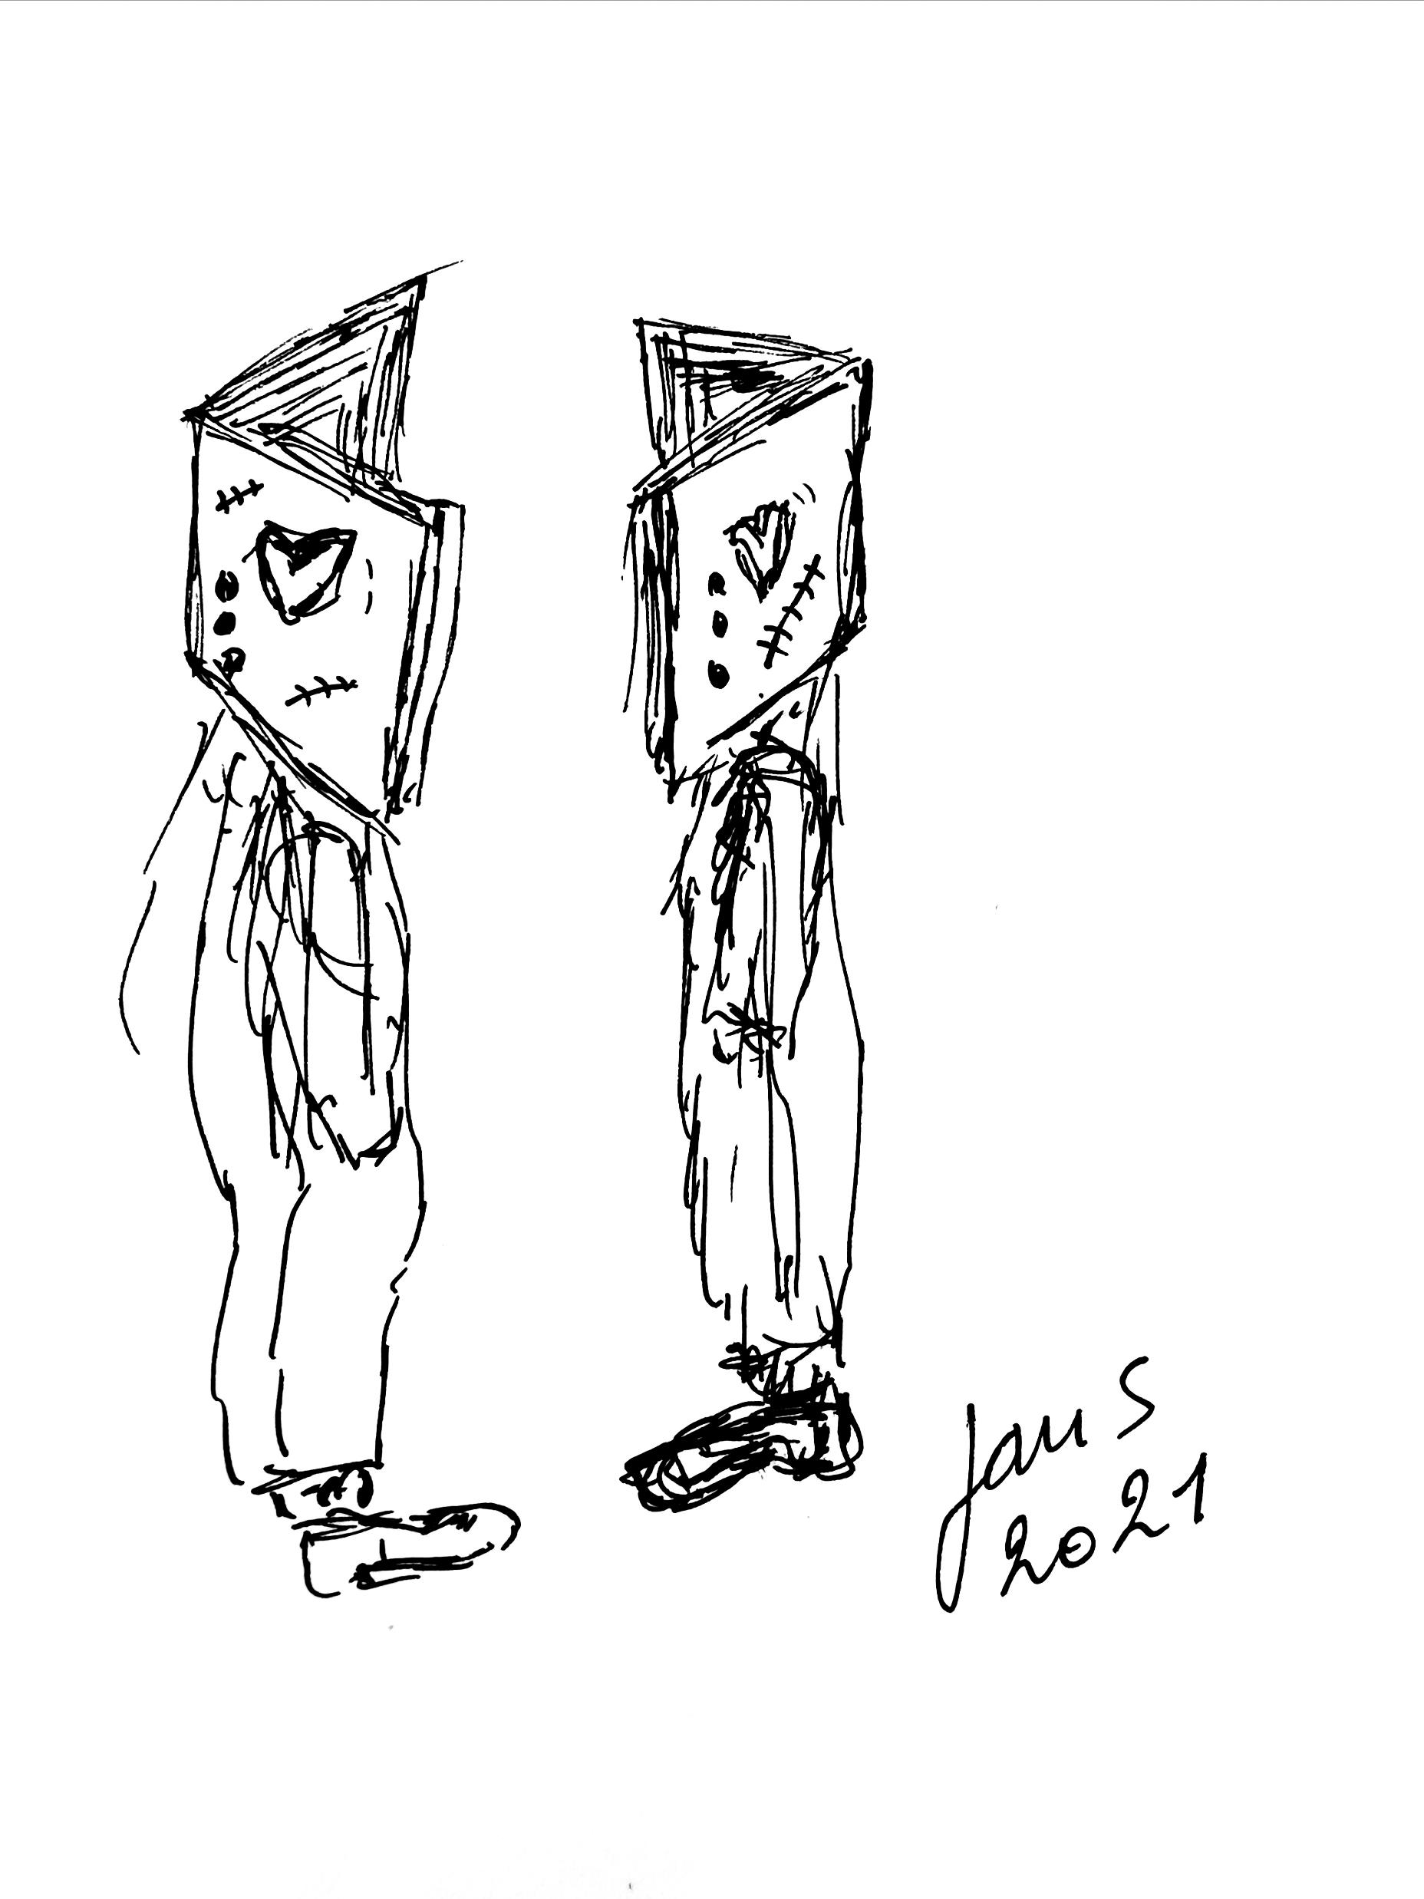
What forms the basis of building a community?
Connections, fruitful connections among humans
Good connections foster openness, engagement, action and results

Slide 21
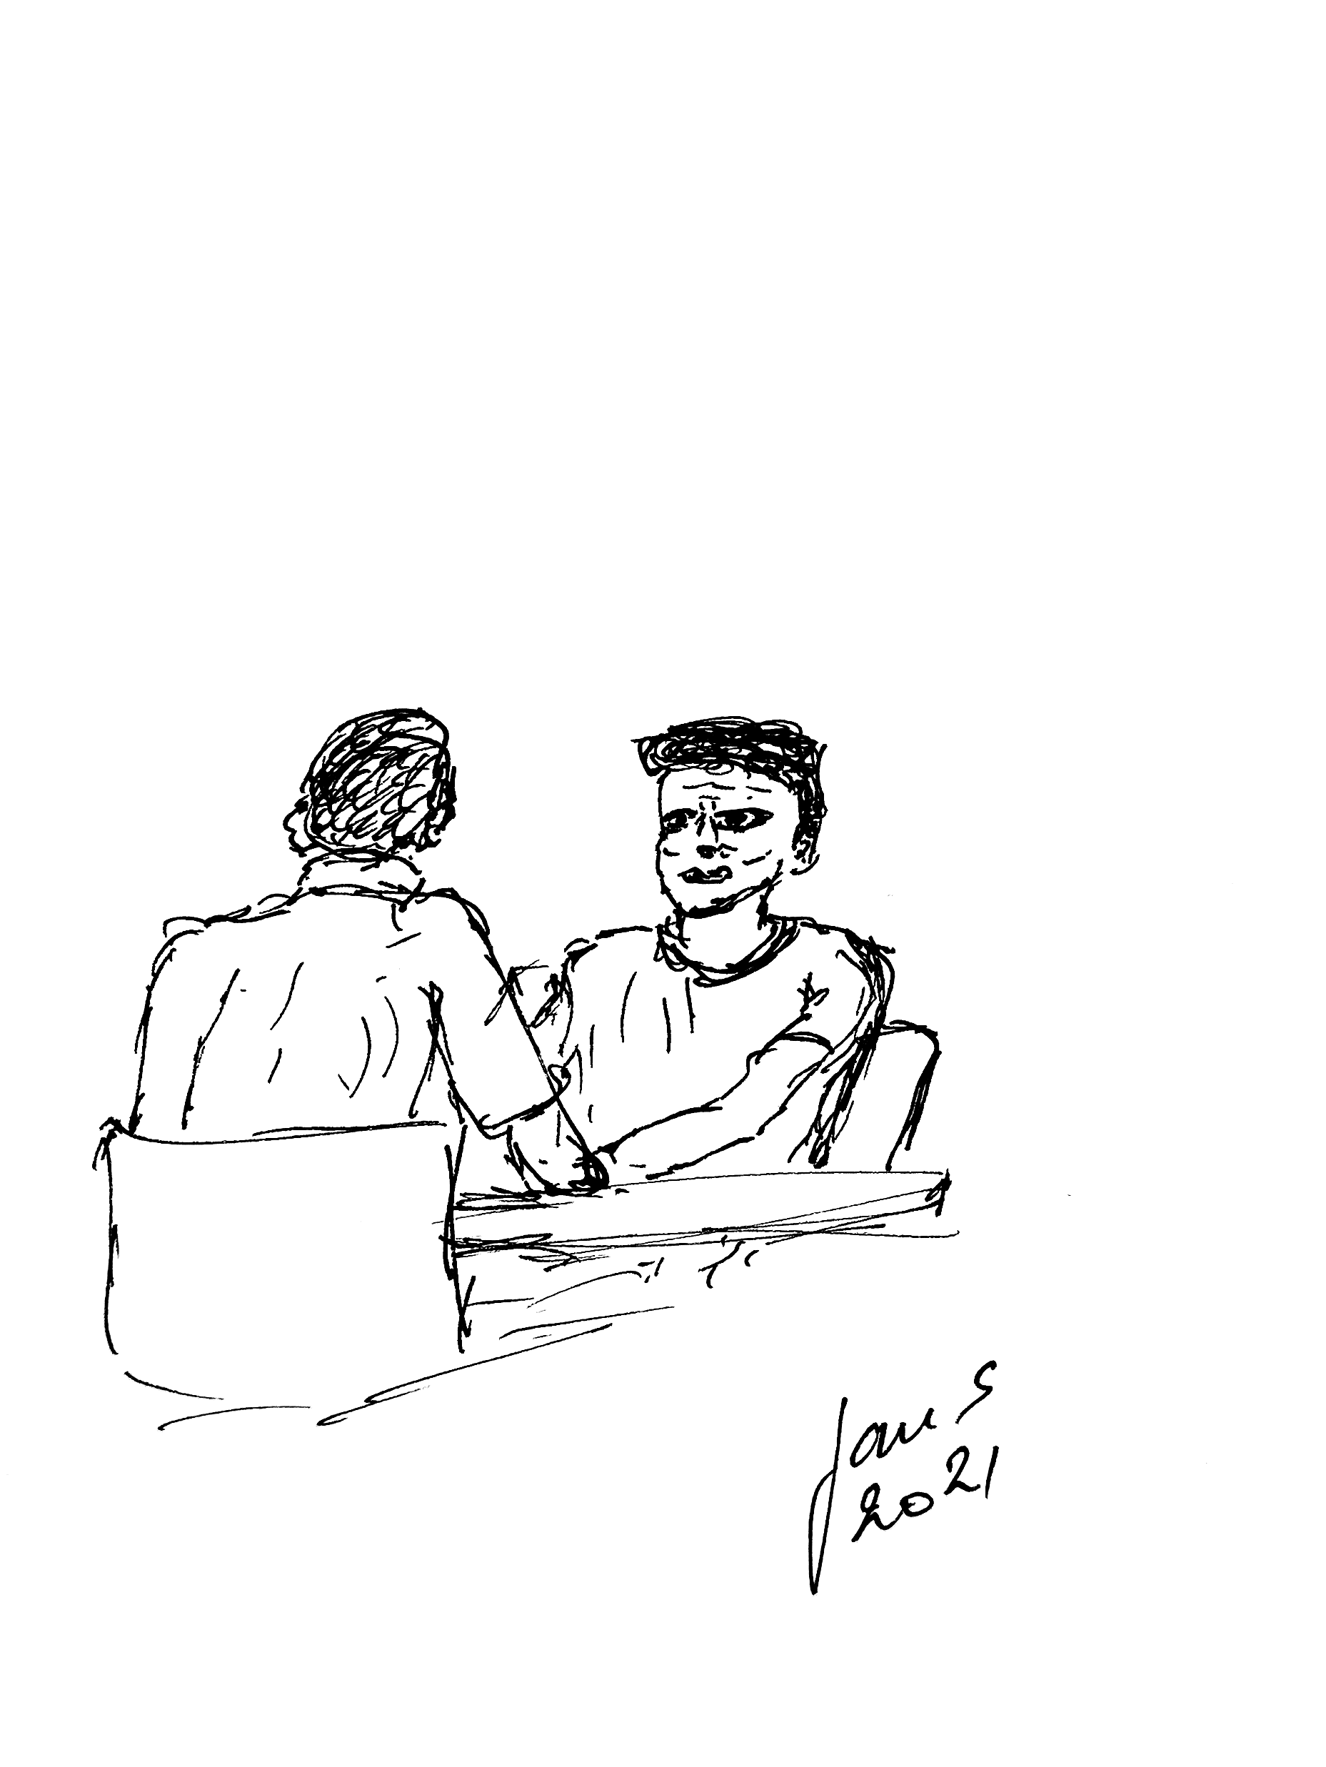
We propose a learning assignment between session 1 and session 2
Within your own neighbourhood, go and have a conversation with 10 people whom you have not spoken to yet. And report back about how it went during our next webinar session. Tell us what went well, what did not work out, what did you did pick up from this assignment?
But prior to finish today: based on what you learned today and your own experience do an appreciatively inquire within your next breakout group into how to start a fruitful conversation to establish connections in your neighbourhood. And discuss what will help you to actually take up the assignment.
Please nominate somebody in your breakout group to do some reporting in the plenary afterwards.

Slide 22
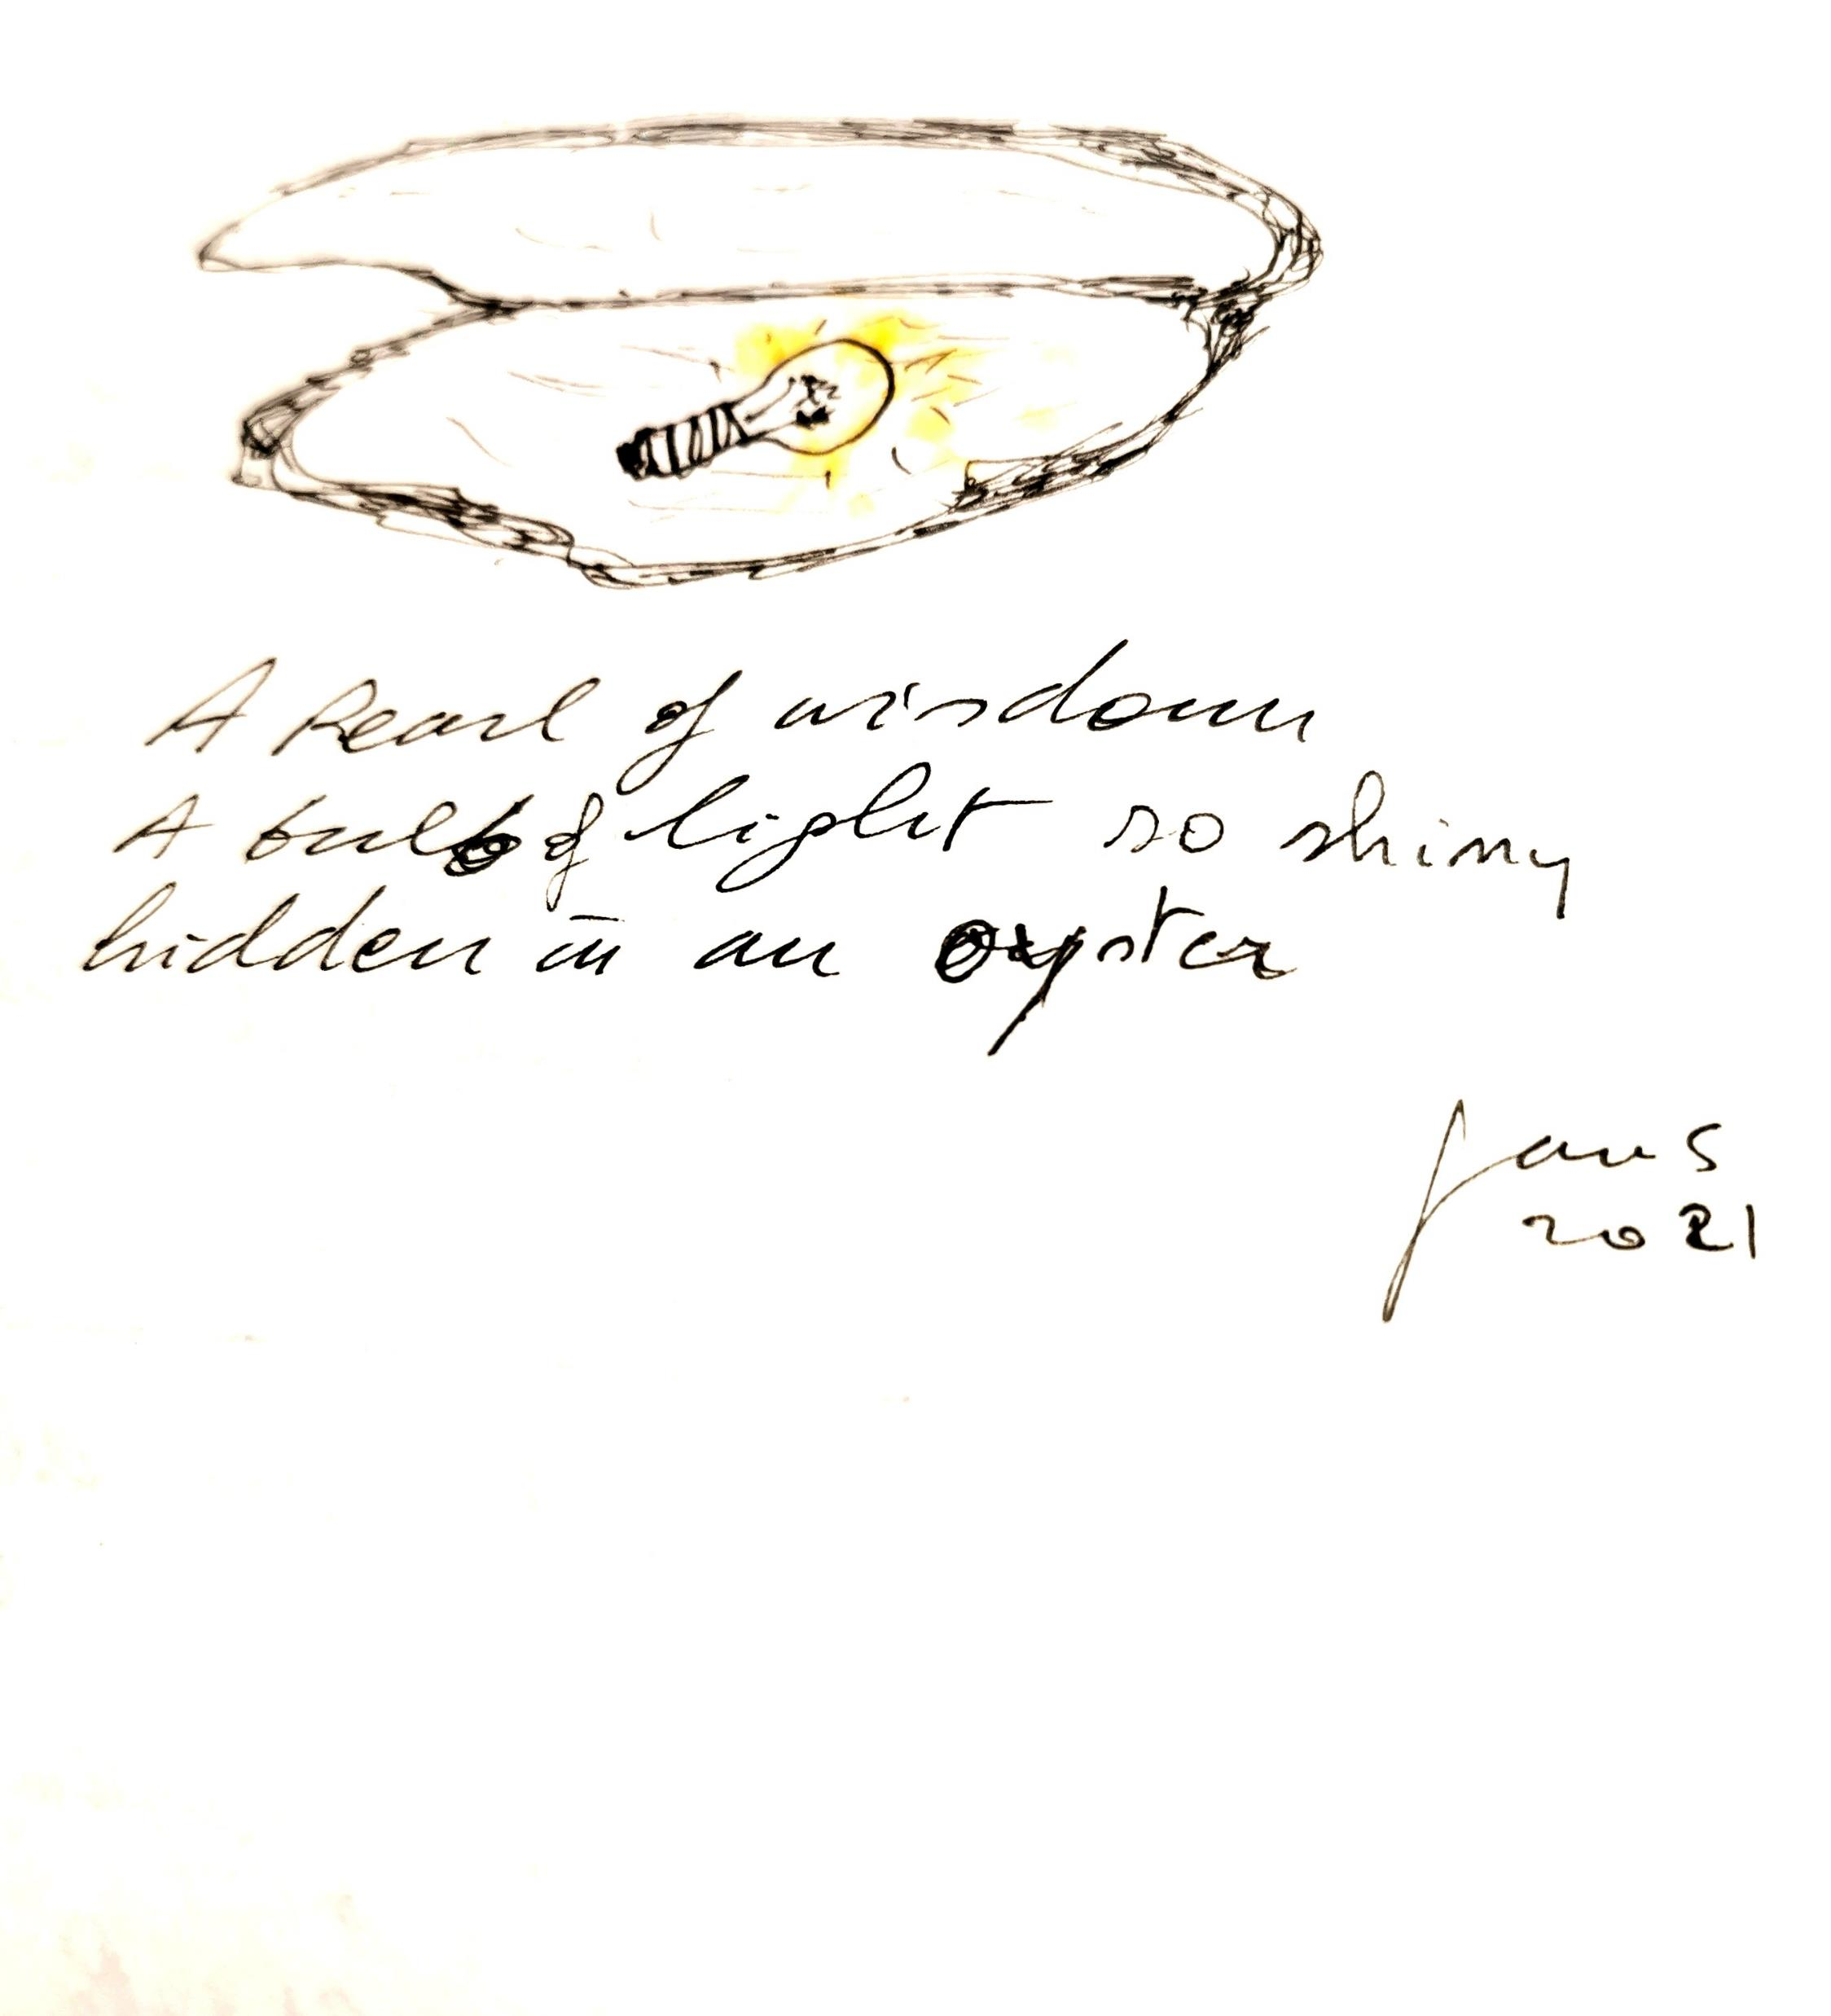
What wisdom surfaced in the breakout groups during the inquiry into the assignment?
How to start a fruitful conversation to establish connections in your neighbourhood?
What helps to take up the assignment?
What else emerged in your subgroup?

Slide 23
Some key lessons I want to share from my experience, from my conversations
S.A.L.T is a crucial attitude and approach for conversations. Authentically connecting with others will transform you. Be prepared to be transformed!
Have a genuine desire to help others to grow, to flourish is important!
Bringing people together can happen in different ways: a small group creating an initial dream to have “a key” to open conversations or bringing a large group together in a SALTy way and build a dream together in a large group setting.
Create some sort of succes indicator for your neighbourhood activities.
Be aware of the power dynamics that play when you are an outsider from the community.
Persistance in trying to connect is important. Don’t give up too soon!
Don not use a corrective but apply a generative and appreciative approach : What gives live to the community? What wants to come alive? What positive narrative can we cowrite ? …
Bring people from a dependence/ victime status into a status of being an agent with talents. Co-map the assets and strenghts of a community for them to flourish with these.
How you are present both on a cognitive level (thoughts), on an emotional level and on a physical level is important.

Slide 24
Key succesfactors for approaching and connecting with a community:
Sincerity
Respectfulness
Compassion
Attentive behaviour
Willing to understand their lingo
Be willing to listen
Learn to reframe bad situations into strengths and positive action focus.
Learn to hold the space for connections, conversations, sharing, learning and listening.

Slide 25
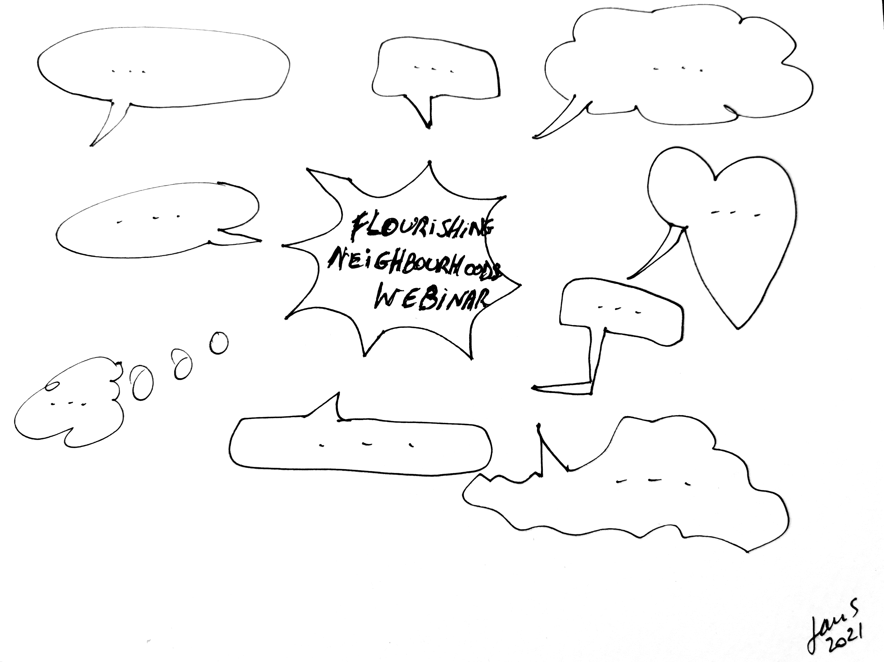
Good luck on your assignment and thank you for being here !
Could you describe in one word/ one sentence what this first session of our webinar did to you/ for you?

